Slide 1
Chapter 5
Genetics and Evolution

Slide 2
Outline
Genetics
Principle of Mendelian Genetics
DNA replication
Cell division
Protein synthesis
Mutations
Genetic engineering
Evolution

Slide 3
Genetics
Genetics studies how traits are passed from parents to their offspring
The study of heredity
Heredity is passing of traits from parents to offspring
Heredity is what makes offspring look like their parents
The basic components of genetics are DNA, RNA, genes, chromosomes and genetic inheritance

Slide 4
Cont’d
DNA molecules hold all the genetic information for almost all organisms
It provides cells with the information they need to perform tasks that allow an organism to grow, survive and reproduce
A gene is one particular section of a DNA molecule that tells a cell to perform one specific task

Slide 5
Cont’d
During reproduction, DNA is replicated and passed from a parent to their offspring
This inheritance of genetic material by offspring influences the appearance and behavior of the offspring
The environment that an organism lives in can also influence how genes are expressed
Genes (the traits they code for) are passed from parent to offspring.

Slide 6
Basic Principles of Mendelian genetics and patterns of inheritance
Gregor Mendel: Austrian monk who discovered the basic principles of heredity through experiments on garden pea
Mendelian inheritance principles were initially controversial and even rejected by some scholars.
When his theories were integrated with the Boveri–Sutton chromosome theory of inheritance by Thomas Hunt Morgan in 1915, they became the core of classical genetics.

Slide 7
Cont’d
Father of modern genetics
He worked with seven characteristics of pea (Pisum sativum) plants: height, pod shape and color, seed shape and color, and flower position and color.
Explained the way in which traits are passed from one generation to the next, and sometimes skip generations

Slide 8
Cont’d
Taking seed color as an example, Mendel showed that when a true-breeding yellow pea and a true-breeding green pea were cross-bred their offspring always produced yellow seeds
However, in the next generation, the green peas reappeared at a ratio of 1 green to 3 yellow
To explain this phenomenon, Mendel coined the terms "recessive" and “dominant" in reference to certain traits
In the preceding example, the green trait, which seems to have vanished in the first filial generation, is recessive and the yellow is dominant

Slide 9
Cont’d
Mendel's findings allowed some scientists to predict the expression of traits on the basis of mathematical probabilities.
An important aspect of Mendel's success can be traced to his decision to start his crosses only with plants he demonstrated were true-breeding.
He expressed his results numerically and subjected them to statistical analysis

Slide 10
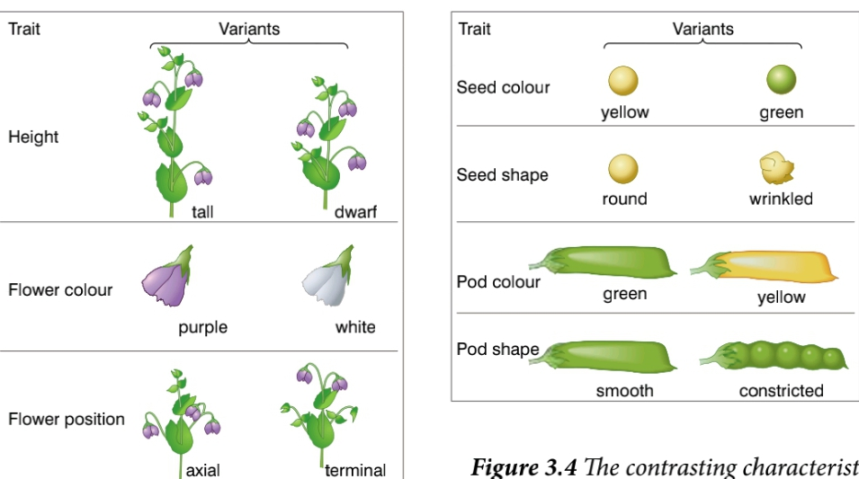

Slide 11
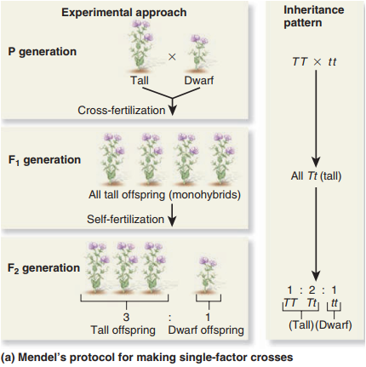
True breeding is a kind of breeding wherein the parents would produce offspring that would carry the same phenotype.
Dominant describes the displayed trait,
Recessive describes a trait that is masked by the presence of a dominant trait

Slide 12
Mendel's conclusions
From this experiment on pea Mendel establishes the following conclusions which were the prerequisite for the establishment of his rules
Characters are unitary. That is, they are discrete (purple vs. white, tall vs. dwarf)
Genetic characteristics have alternate forms, each inherited from one of two parents. Today, we call these alleles
One allele is dominant over the other. The phenotype reflects the dominant allele
Gametes are created by random segregation. Heterozygotic individuals produce gametes with an equal frequency of the two alleles
Different traits have independent assortment. In modern terms, genes are unlinked

Slide 13
Mendel's three laws of inheritance
Law of Segregation: states that the two alleles for a heritable character segregate (separate from each other) during gamete formation and end up in different gametes.
Law of Independent Assortment: genes for different traits segregate independently of each other. It means that separate traits are separately inherited.
Law of Dominance: says there are dominant and recessive traits. Dominant traits which phenotype is expressed in an organism that is heterozygous for the trait.

Slide 14
Molecular genetics and inheritance
Structure of DNA and Chromosome
DNA (deoxyribonucleic acid)
Contains a code that can be used by a cell to express certain genes
DNA comes in the form of a long, linear molecule referred to as a strand.
The basic unit of DNA strand is a nucleotide

Slide 15
Cont’d
There are four types of nucleotides:-
Adenine (A) containing nucleotide
Guanine (G) containing nucleotide
Cytosine (C) containing nucleotide
Thymine (T) containing nucleotide (in DNA, or Uracil (U) nucleotide in RNA)
Nucleotides have three units (Pentose sugar, Phosphate and Nitrogenous base)

Slide 16
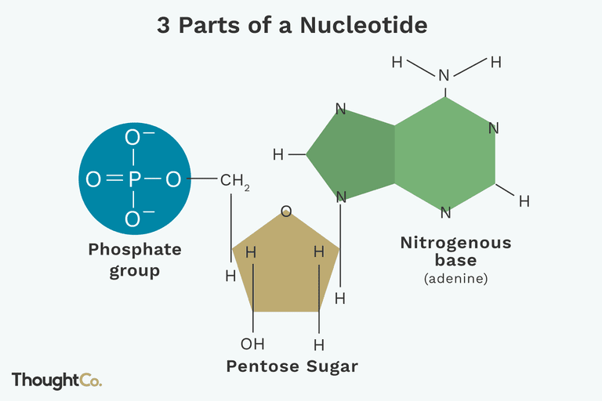

Slide 17
Cont’d
Nitrogenous bases can be classified as:
Purines: adenine and guanine
Pyrimidines: thymine, cytosine, uracil
Nucleotides are connected by phosphodiester bonds
linkage formed between sugar of one nucleotide and phosphate of another nucleotide

Slide 18
Cont’d
DNA is double helix: two polynucleotide strands connected by hydrogen bonds
strands are antiparallel
5’ end - 3’end
polynucleotide strands are complementary
A–T and C–G
If the sequence of bases on one strand is known, the sequence of bases on its complementary strand can be intuitively inferred.

Slide 19
Cont’d
In DNA, the bases b/n two strands interact via hydrogen bonds
The formation of base pairs follows two rules
A & T form two hydrogen bonds with each other
C & G form three hydrogen bonds with each other
DNA carries hereditary information between generations
Determining the sequence of bases helps reveal evolutionary relationships
The closest living relative of humans is the chimpanzee (share 98% DNA sequence)

Slide 20
DNA Replication
Video link: https://youtu.be/TNKWgcFPHqw
C:\Users\TOSHIBA\Downloads\DNA replication - 3D.mp4
The ability of DNA to make copy of itself is the basis for reproduction and inheritance
DNA synthesis occurs bidirectionally from an origin of replication.
The synthesis of new DNA strands happens near each replication fork
DNA replicates semi-conservatively
Each new DNA molecule contains one strand from the original (old) DNA and one new strand DNA molecules
Both new DNA molecules formed are identical to each other and to the original molecule

Slide 21
Enzymes Required for DNA Replication
Helicase: break H-bonds to reveal two single strands and unwind (open) the DNA helix
DNA polymerase: multiple types, responsible for the actual synthesis of DNA
Primase: Adds an RNA primer so that DNA synthesis can begin
Exonuclease: Remove RNA primers at the 5’ ends of newly synthesized DNA so that the polymerase activity can fill in the resulting gaps
Ligase: Joins together small newly synthesized pieces of DNA called Okazaki fragments
Notes:
21

Slide 22
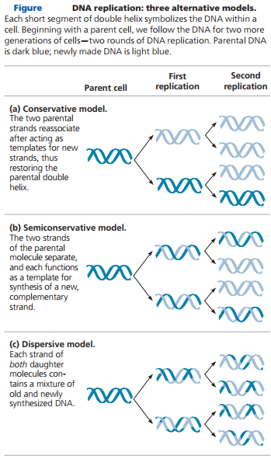
Possibilities of DNA replication
Notes:
22

Slide 23
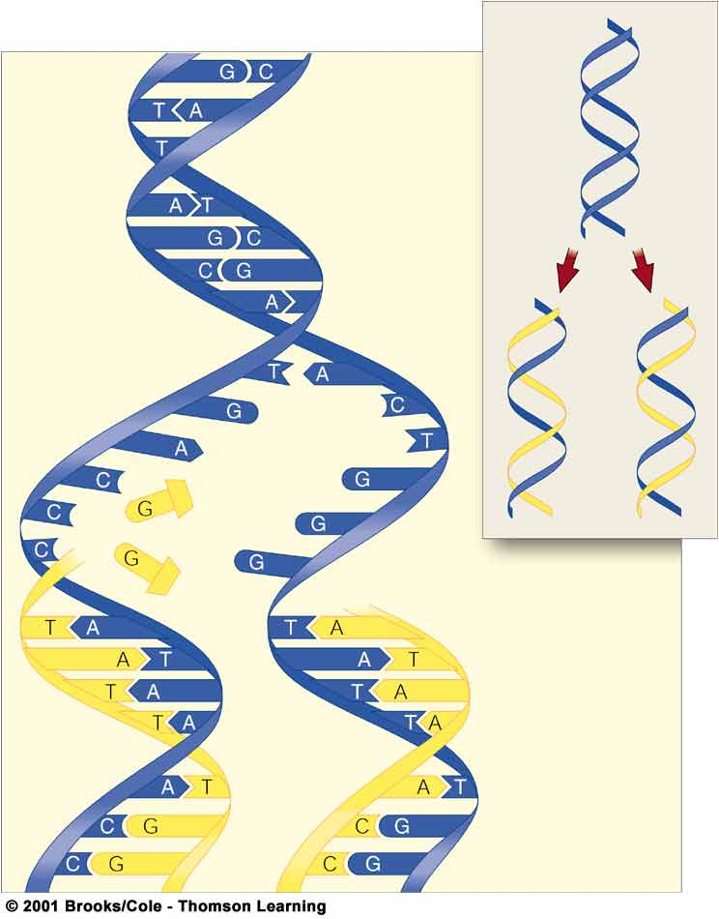
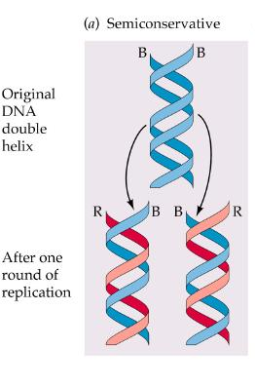
How does DNA replicate or synthesized?
old
new
new
old
Semi-Conservative DNA replication
Notes:
23

Slide 24
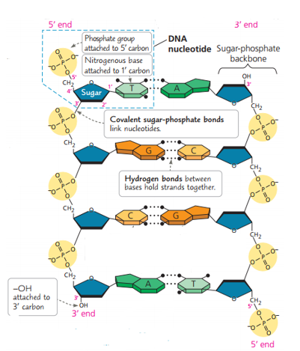
Notes:
24

Slide 25
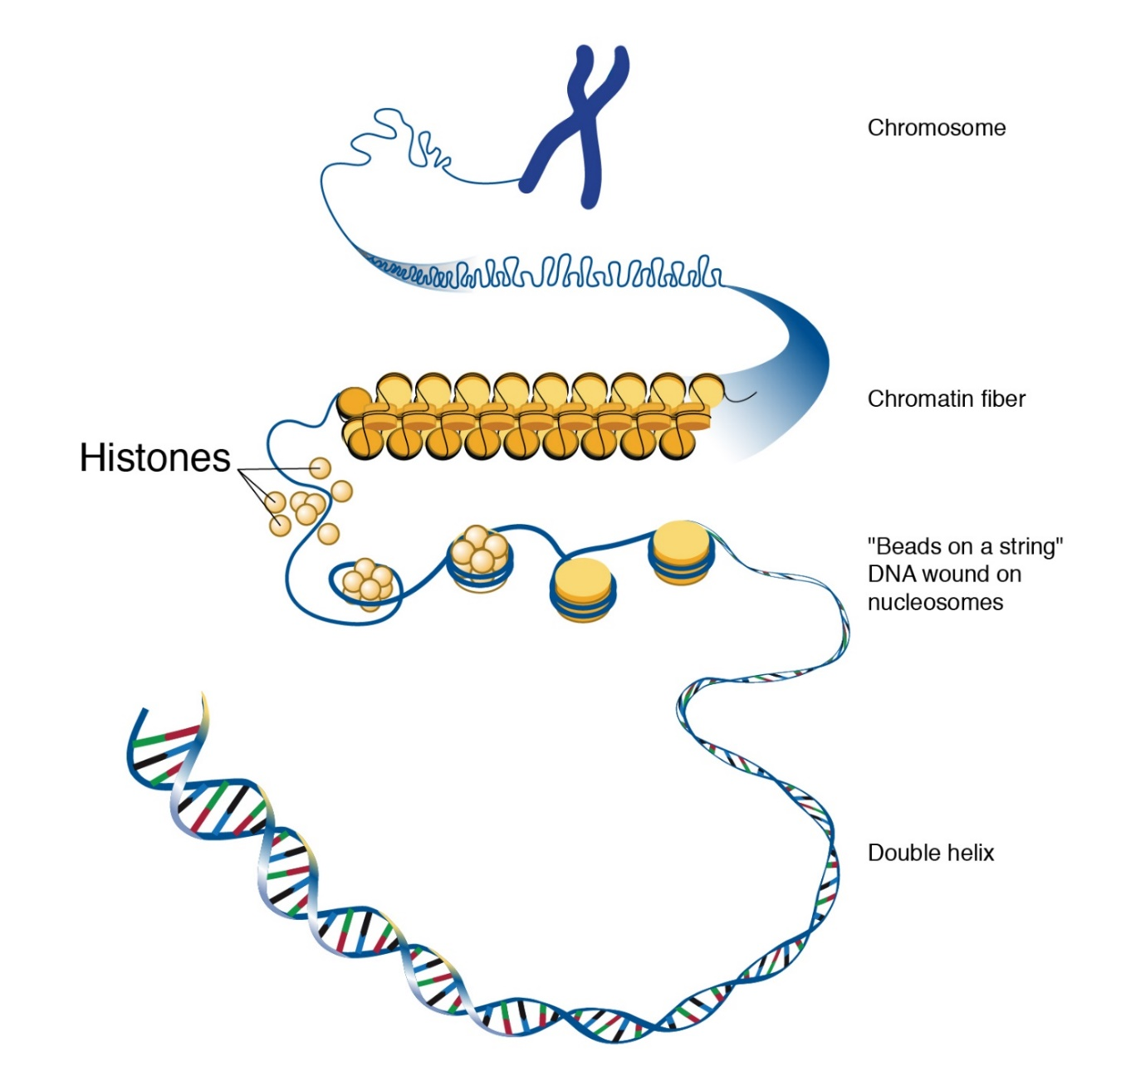
Condensing DNA into chromosomes
The double helix DNA molecule winds around protein called histones
Eight of these histones group together to form a unit nucleosome
These nucleosome then wrap around in helical fashion to form a coil called a solenoid. The coil wraps even further to form supercoils. These supercoils form a fiber of DNA-protein called chromatin.
These chromatin fiber condenses even further into a substance called the chromosome.

Slide 26
Cont’d
Chromosome is a thread- like structure that is made up of DNA and histone proteins
DNA is the molecule that stores genetic information
Histone is the core of a chromosome around which chromosome‘s DNA wrapped
Chromatin is the loosely organized form of chromosome throughout the nucleus in loops when the cell is not dividing

Slide 27
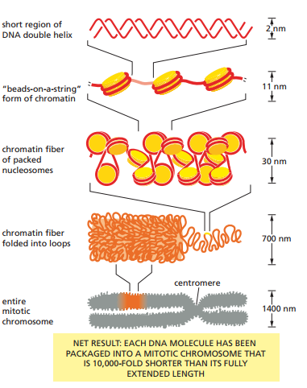

Slide 28
Phases of the Cell Cycle
Cell cycle is the duplication and division of cell
1. Interphase: It takes the longest period of time
G₁ – 1st Gap phase (primary cell growth phase)
S – synthesis; DNA replicated
G₂ – 2nd Gap phase (secondary growth phase)
a cell synthesizes the proteins necessary for chromosome sorting and cell division
2. Mitosis – M : the shortest period
divide one cell nucleus into two nuclei
3. Cytokinesis- In most cases, mitosis is followed by cytokinesis, which is the division of the cytoplasm to produce two distinct daughter cells.

Slide 29
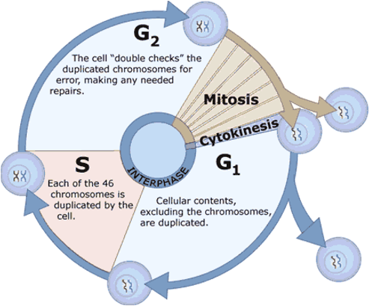
Phases of the Cell Cycle cont’d

Slide 30
Cell division
Is the process by which a parent cell divides into two or more daughter cells
The primary concern of cell division is the maintenance of the original cell's genome
In eukaryotes, there are two distinct types of cell division
1. Mitosis
Vegetative division, whereby each daughter cell is genetically identical to the parent cell
allows for continual construction and repair of the organism

Slide 31
Cont’d
2. Meiosis
Reproductive cell division, whereby the number of chromosomes in the daughter cells is reduced by half to produce haploid gametes
Meiosis results in four haploid daughter cells by undergoing one round of DNA replication followed by two divisions.

Slide 32
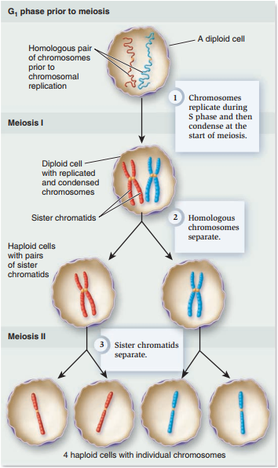
Cont’d
Homologous chromosomes are separated in the first division
Sister chromatids are separated in the second division

Slide 33
Prokaryotes undergo a vegetative cell division known as binary fission, where their genetic material is segregated equally into two daughter cells
There are also alternative manners of division, such as budding
For simple unicellular microorganisms such as amoeba, one cell division is equivalent to reproduction; an entire new organism is created

Slide 34
Mitotic cell division can create progeny from multicellular organisms, such as plants that grow from cuttings
Before division can occur,
the genetic information that is stored in chromosomes must be replicated, and
the duplicated genome must be separated cleanly between cells.
A great deal of cellular infrastructure is involved in keeping genomic information consistent between generations.

Slide 35
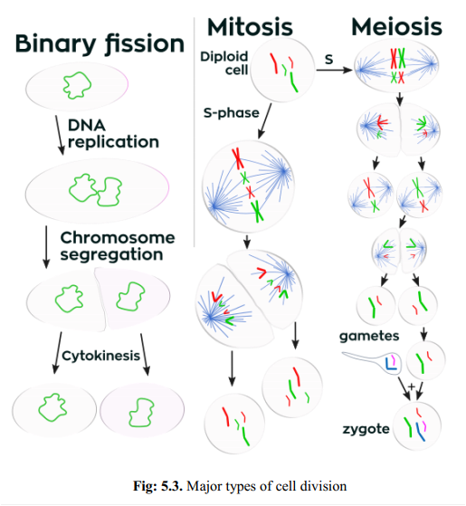

Slide 36
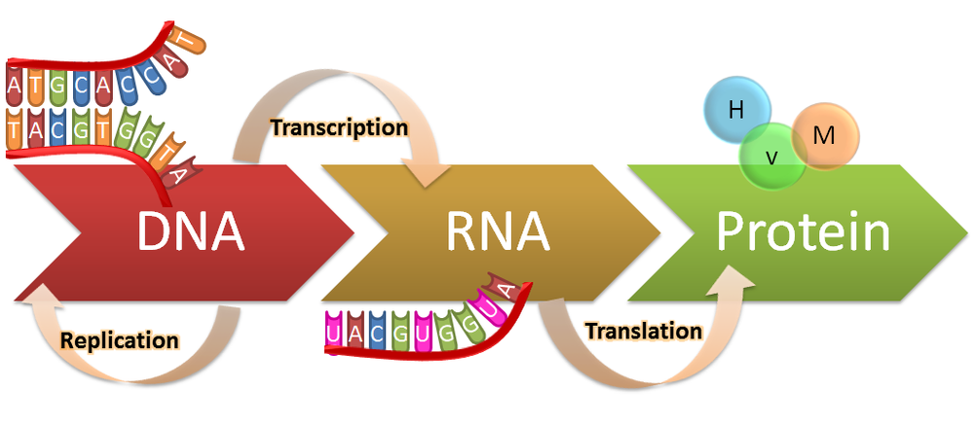
Protein synthesis
Code for protein synthesis is specified by DNA and has to be sent to ribosome
Gene expression is the process by which DNA directs the synthesis of proteins
The expression of genes that code for proteins includes two stages:
Transcription is the synthesis of RNA using information in the DNA
Translation is the synthesis of a polypeptide using the information in the mRNA.

Slide 37
Eukaryotes have nuclear envelopes that segregate transcription in the nucleus from translation in the cytoplasm; thus in a two step process:
Transcription of a eukaryotic gene results in pre-mRNA that is Primary transcript.
Primary transcript: An initial RNA (pre-RNA) transcript in eukaryotic nucleus
2. Pre-mRNA is modified in the nucleus to yield the finished mRNA that moves from the nucleus to the cytoplasm where translation occurs . This RNA processing occurs only in eukaryotes.
Notes:
In addition, before the primary transcript can leave the nucleus it is modified in various ways during RNA processing before the finished mRNA is exported to the cytoplasm

Slide 38
mRNA Splicing
Eukaryote genes made up of Exons and Introns
mRNA transcripts contain both exons and introns when first synthesised
Intron sequences removed from mRNA by Splicing in the nucleus
Occurs in eukaryotes, but not in prokaryotes mRNA

Slide 39
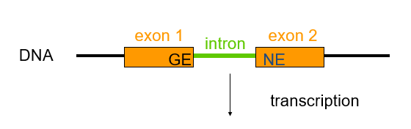
Genetic information is transferred from genes to the proteins they encode via a “messenger” RNA intermediate
intron
pre-mRNA
RNA splicing
mRNA
translation
protein

Slide 40
Events during protein synthesis
Transcription- DNA code for protein is rewritten in a molecule of mRNA
mRNA travels from nucleus to ribosome
Free amino acids are transported from cytoplasm to ribosome by transfer RNA (tRNA) molecules
Ribosome read mRNA code and assembles amino acids presented by tRNA into a protein by a process-translation

Slide 41
Genetic code
Transcription: Process of copying a specific portion of DNA (gene), producing a complimentary strand of mRNA
Occurs in the nucleus of eukaryotic organisms
RNA polymerase attaches to a promoter site, part of the DNA strand that codes for a gene, and separates that section of the DNA strand
RNA polymerase uses one DNA strand as a template to assemble nucleotides into a complementary strand of mRNA.
This follows the base pairing rules for DNA replication except that in RNA, uracil rather than thymine, pairs with adenine

Slide 42
Genetic code cont’d
3. Once polymerase reaches the terminator site (end of the gene), mRNA separates from the DNA strand & leaves the nucleus then DNA strands rejoin or zip closed
The strand of mRNA that is made during transcription has two regions
Exon – code for protein
Intron – non coding section
In order for the mRNA to be used in translation the non-coding introns need to be removed by spliceosome
Then the formed mRNA (exon only) leaves the nucleus for translation in ribosome

Slide 43
Cont’d
Nitrogenous bases are grouped in to three latter code called codon w/c codes for specific amino acid/ 3RNA base sequences
The genetic code consists of 64 codons
But only 61 code for amino acids (for the 20 amino acids)
One codon, AUG, codes for methionine, and functions as a start signal for ribosomes to begin translating the mRNA at that point
Three codons act as signal to stop the process (UGA, UAG and UAA) where ribosomes end translation.
Most amino acids have more than one code, only methionine and tryptophan have one code (Arginine has six codes)

Slide 44
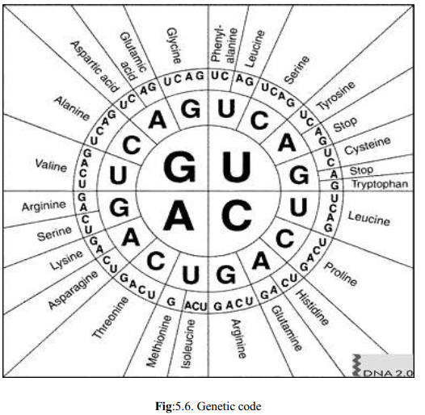

Slide 45
Translation
Process in which mRNA code is converted into a sequence of amino acids (from RNA to protein) occur in ribosome
1. Translation begins with binding of small ribosomal sub unit to mRNA strand upstream of the start codon
Each amino acid is brought to ribosome by specific tRNA
The type of amino acid is determined by the anticodon sequence of the tRNA
2. Complementary base pairing occur between the codon of mRNA and anti-codon of tRNA (initiator tRNA)

Slide 46
Translation Cont’d
3. After the initiator tRNA binds to the start codon, the large ribosomal sub unit binds to form translation complex and initiation is completed
In the large ribosomal sub unit there are sections called E, P and A site
4. During elongation individual amino acids are brought to mRNA strand by tRNA molecule through complementary base pairing of codon and anti-codon
Each anticodons of tRNA molecule corresponds to a specific amino acid

Slide 47
5. Charged tRNA molecule binds to the A site and a peptide bond formed between the amino acid and the attached tRNA molecule at the P site
6. The complex slides down one codon to the right where the uncharged tRNA molecule exit from the E site and the A site is open to accept the next tRNA molecule
Elongation will continue until stop codon is reached
7. When stop codon is reached, release factor binds to A site and polypeptide is released from the P site then the entire complex dissociates

Slide 48
Translation summary
During translation, the cell uses information from messenger RNA to produce proteins.
Transcription occurs in nucleus.
mRNA moves to the cytoplasm then to the ribosomes. tRNA “read” the mRNA and obtain the amino acid coded for/identifies amino acid carried
Ribosomes attach amino acids together forming a polypeptide chain.
Polypeptide chain keeps growing until a stop codon is reached.

Slide 49
Mutations
Mutation is the change in the nucleotide sequence of genome of an organism
May occur in somatic cells (can’t pass to offspring)
May occur in gametes (eggs and sperm) and be passed to offspring
Mutation could occur spontaneously (accidentally) during duplication
Rare events

Slide 50
Cont’d
Each new cell has an average 120 mutations. But
Most mutations detected & repaired
95% of our DNA is non-coding, most mutation unlikely to affect coding gens.
Causes of mutation
Replication errors
Mutagens, such as UV rays and chemicals

Slide 51
Types of mutation
The ways that DNA can be changed, resulting in different types of mutation
Mutation can be gene or chromosomal 1. Gene mutation: result from changes in a single gene.
Point mutations- changes that involves a single base. Affect one nucleotide thus occurring at a single point on the gene
A. Substitution- one base is replaced by other base
Transversion: purine is replaced by a pyrimidine or a pyrimidine is replaced by a purine
Transition: Purine is replaced with a purine or pyrimidine is replaced with a pyrimidine

Slide 52
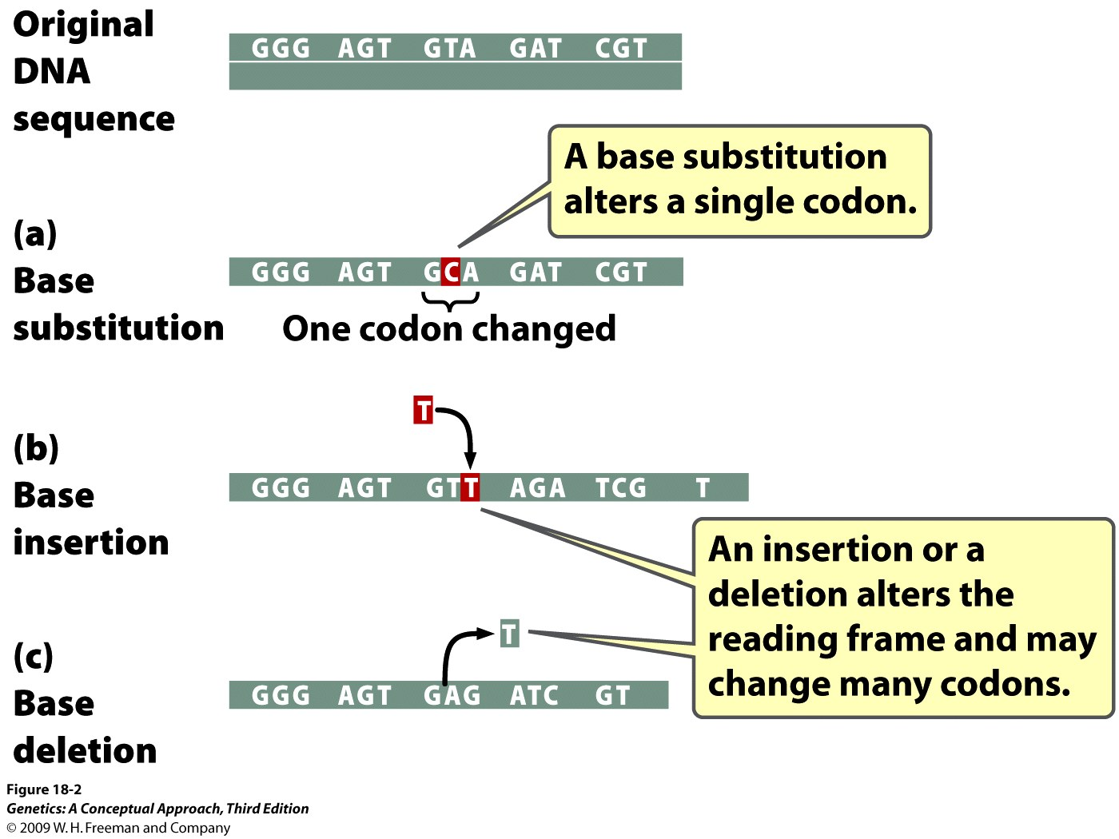
Cont’d
B. Addition- an extra base is added
C. Deletions –a base is missed out during DNA replication

Slide 53
2. Chromosomal Mutations- situation where part of a chromosome sequence of DNA is missed/added
Chromosomal mutations can happen in either of the following
1. Deletion
The loss of an inner chromosomal fragment- or when an end of a chromosome breaks off.
2. Insertion
The presence of a chromosome segment more than once in the same chromosome

Slide 54
Chromosomal Mutations cont’d
3. Inversion
the change of direction of a chromosomal segment when it breaks out and is re-inserted backwards
4. Translocation
The movement of chromosomal segments from one chromosome to another, non-homologous chromosome
NB. Euploidy/polyploidy-is a condition where a cell has one complete set of extra chromosomes
Aneuploidy – is a condition where a cell lost or added one or more chromosomes from/to the normal set of chromosome

Slide 55
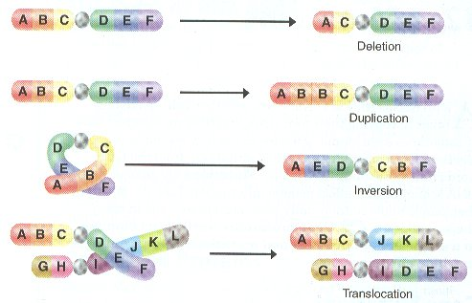

Slide 56
Consequence of mutations
Mutations on body cell (non- sex cell) cannot be inherited but may result in one of the following:
Useful
The fuel for evolution: can create new species
2. Harmless
Silent mutation
Different codon but still encodes for same amino acid
Neutral mutation
Missense mutation that changes amino acid sequence, but does not alter function of protein
3. Harmful: cause disease, damage the cell and kill the cell

Slide 57
Manipulation of DNA : Genetic engineering
Genetic engineering is a process by which the genome of an organism is altered, usually by having extra gene from d/t organisms
The organism is termed genetically modified organism (GMO), transgenic organism or genetically engineered organism
The immediate importance of genetic engineering may depend on the type of organism that gates engineered
Bacteria
to produce useful products
Insulin, Antibiotics, Enzyme for food processing industry, Human growth hormone and Vaccines

Slide 58
Plants are also genetically modified
To absorb more CO₂
Disease (drought) resistant
Improved yield
To produce specific product
Animals are genetically modified for the following purposes
High growth rate
High yield of protein
Detection of water pollution
Disease resistant

Slide 59
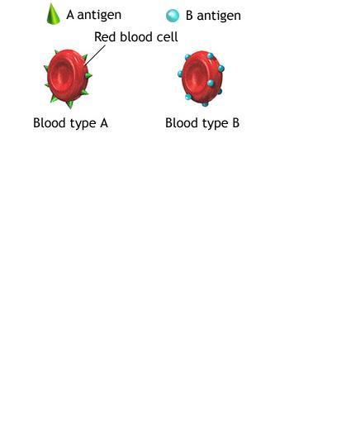
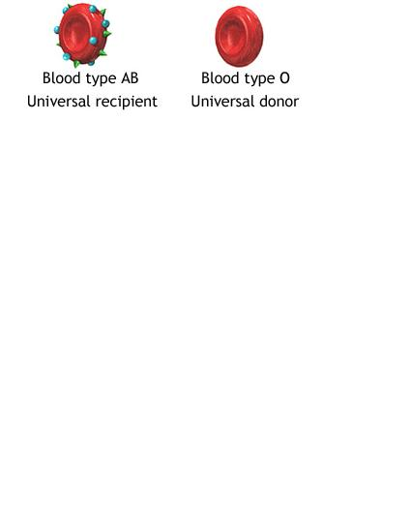
ABO blood groups and Rh Factors
ABO blood group is based on the presence ( or absence) of 2 major antigens (A and B) on the surface of RBC
If persons antigen on the surface of RBC is –
Only A = A blood type
Only B = B blood type
Both A and B = AB blood type
Neither A nor B = Type O blood

Slide 60
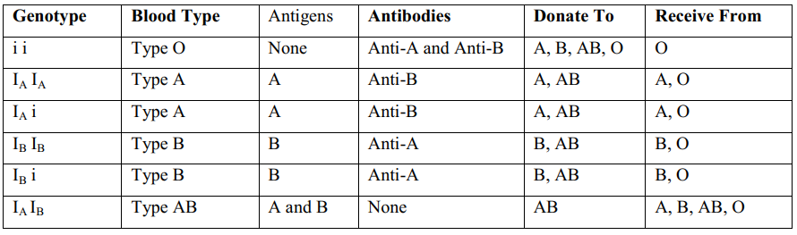
NB.
Because of the lack of antigens on its surface an Blood type O can donate to all blood types for this reason an individual with blood type O is called Universal blood donor
An individual with blood Type AB is Universal blood recipient

Slide 61
Rh Factor (D antigen)
Blood type is usually expressed as a letter followed by either a positive (+) or negative (-)
This positive and negative indicates the Rh factor
The Rh factor determines the presence or absence of a protein (D antigen) on the surface of the RBC
Genotypes for the Rh factor are +/+, +/-, and -/-
People who are +/+ or +/- possess the Rh(D) antigen and test as Rh positive
People who are -/- do not possess the Rh(D) antigen and test as Rh negative
Unlike ABO antigens, Rh antigens are present only on red blood cells
Genotype | Phenotype | Blood Proteins | Blood Antibodies | Donate To | Receive From
+/+ | Rh+ | Rh(D) | None | Rh+ | Rh+ or Rh-
+/- | Rh+ | Rh(D) | None | Rh+ | Rh+ or Rh-
-/- | Rh- | None | Anti-Rh(D) | Rh+ or Rh- | Rh-

Slide 62
Rh Sensitization
One interesting medical scenario involves an Rh negative mother who carries an Rh positive baby
The baby of an Rh positive father and an Rh negative mother can be +/- or -/-
If the baby is +/-, the first pregnancy causes Rh sensitization in the mother, because she is exposed to foreign proteins and builds up antibodies against them

Slide 63
Rh Sensitization cont’d
Future pregnancies can be increasingly difficult, as the mother's antibodies attack the baby
To avoid develop antibodies against the Rh D antigen the mother should receives an anti-D injection soon after first delivery or abortion
If not In 2nd child, hemolytic disease of the newborn may develop causing hemolysis of the fetal RBCs → anemia and jaundice
Anti-D binds to fetal red blood cells and remove them from body before she reacts

Slide 64
Introduction to Evolution
Evolution
Gradual change of an organisms on the earth over long periods, with new forms replacing old ones.
As evolution has progressed, new species are arising, biodiversity of the planet increasing, larger and more complex organisms replaced the smaller and some species has get extinct
Theories of Evolution
Theories of evolution explains
How does evolution happen? and
What drives the population to become a new species?

Slide 65
A. Lamarck theory of evolution
In 1809, Lamarck published a paper entitled Philosophic Zoologique‘
described two-way mechanism by which change is gradually introduced into the species and passed down through the generations
The two parts of Lamarck theory are:
Use and disuse
structure or process in organism that can be used continuously will become enlarged or more developed but any structure that is not, will be reduced
Neck of giraffe
wings of penguins

Slide 66
2. Inheritance of acquired traits
Lamarck believed that traits acquired during an organism‘s lifetime could be passed to its offspring
Example: - Giraffe that had acquired long necks would have offspring with long neck
NB. Nowadays, Lamarck‘s theories are not accepted
Because the environmental changes that were believed by Lamarck have brought about the changes in the phenotypes (Physical appearance) of the organisms have no effect on their gametes and hence their heredity

Slide 67
B. Charles Darwin and Natural Selection
In 1858, Charles Darwin and Alfred Wallace jointly published a scientific paper on:
species were modified by natural selection
Darwin studied finches found on five of the Galapagos Islands, made drawings, and collected species
He noted there were many similarities between them but have some obvious differences
Darwin concluded that an ancestral finch had colonized the Islands from mainland and been able to adapt to the different conditions on the islands and evolve into different species.
E.g. He suggested that some finches had evolved into insect eaters (pointed peak), other in to seedeaters (crushing peak)

Slide 68
Darwin summarized his observations in two main ideas
All species tend to produce more offspring than can possibly survive (Fecundity)
There is a variation among the offspring
From these observation Darwin concluded that:
There will be a struggle for existence between members of a species because they are over – reproduced and resources are limited.
Some members of a species will be better adapted than others to the environment because there is a variation in the offspring
Darwin proposed
Those members of a species, which are best adapted to their environment, will survive and reproduce in greater number than other less adapted (died out)

Slide 69
C. Neo-Darwinism Theory
Charles Darwin did not propose how a variation in the population was passed to the next generation
Now day‘s genes and gene action are the driving force of evolution in the theory of Natural selection
Neo-Darwinism is a modification of Darwin‘s original theory that takes into account: - genetics and ethology
A Gene pool is all the alleles in the population. A population might evolve into a new species

Slide 70
Suppose an allele determines a feature that gives an organism an advantage in its environment. The following will happen
Those individuals with the advantageous allele of a gene will survive to reproduce in greater number than other types
Advantageous alleles pass to their offspring in greater numbers than other genes (alleles)
The frequency of the advantageous allele will be higher in the next generation of a population
Mutations are important in introducing variation into population

